Slide 1



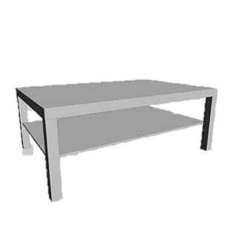
Researchgap
Research gap: Human modeling and understanding in Task allocation is unknown, especially individualized profiles
Task division between human and robot
Requires modeling of human
But how to model human capabilities?

Slide 2
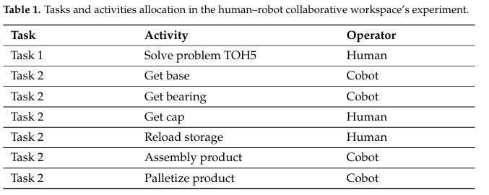
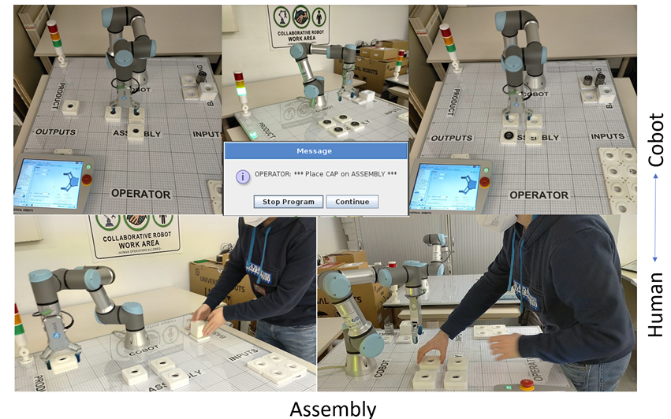
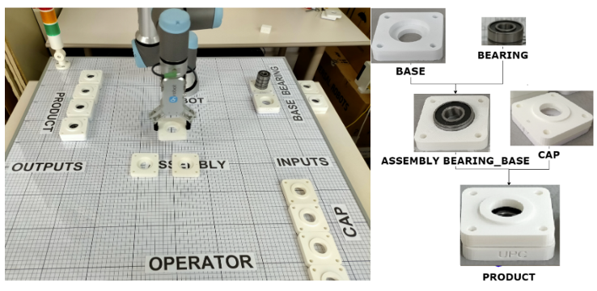
State of the art:
Paper: Cognitive Interaction Analysis in Human–Robot Collaboration Using an Assembly Task
Interface: simple
Use case: Assembly of a product composed of 3 components: a base, a bearing and a cap
Implementation:

Slide 3



Study Setting
Experiment:
Training session
Pre-questionnaire: To Create Human capability matrix
Let them do the task under the time pressure, produce 3,4 parts
Let them decide on the Adaptive task allocation
Post-questionnaire: Why they assigned the tasks to robots
Result: Any pattern between human capability and allocation?
Doubts:
- There might be no correlation and result at the end
- Why should the human assign any task to the robot? The other agent should be able to work parallel
Discussion:
Gamified with time limitation
They give more score if they do it by themselves but not possible to not use the robot
Around 100 participants and good design
Potential hypothesis: Time pressure and accuracy effect on decision making
TA comparison between h-h and h-r
Physical and psychological test for human capability profile afterwards will find the use case
Design of experiment is the most important thing
The first round should be as easy as popssible
Task:
Pick & Place
Screw
Palletizing
Quality check
Wire handling
….
Human Capability/skill:
Pick & Place
Screw
Palletizing
Quality check
Wire handling
….
Task allocation
$$\left[\begin{aligned}T1 \\ T2 \\ T3 \\ T4 \\ T5 \\ …\end{aligned}\right]$$
$$\left[\begin{aligned}C1 \\ C2 \\ C3 \\ C4 \\ C5 \\ …\end{aligned}\right]$$
$$\left[\begin{aligned}T1→h \\ T2→r \\ T3→r \\ T4→h \\ T5→h \\ …\end{aligned}\right]$$
Result?
Human will allocate the tasks
Pre-questionnaire: Human capability matrix
Post-questionnaire: Capability vs TA
training

Slide 4
Study Setting- next steps
Human modelling:
In the next scenario we add a human agent who is capable of doing all tasks
Let the participant do the Task allocation
How does he/she allocate task between him, the other human and robot
TA between human-human and human-robot
Participant do the allocation

Slide 5
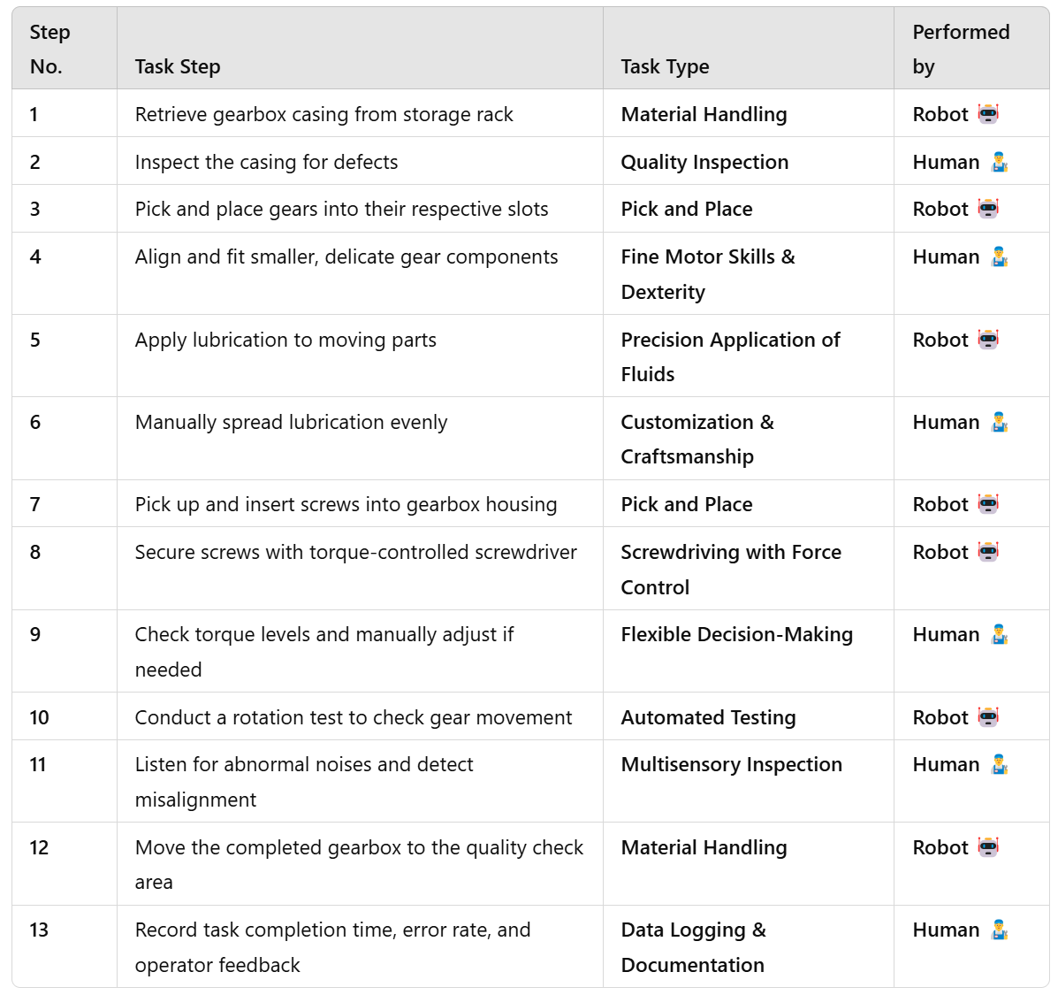
Study Setting- use case example
assembly of a small gearbox

Slide 6
Next steps:
Next steps:
SLR_Measurable human capabilities and matching with standard task types
Then work on the pilot study– keep it as simple as possible

Slide 7
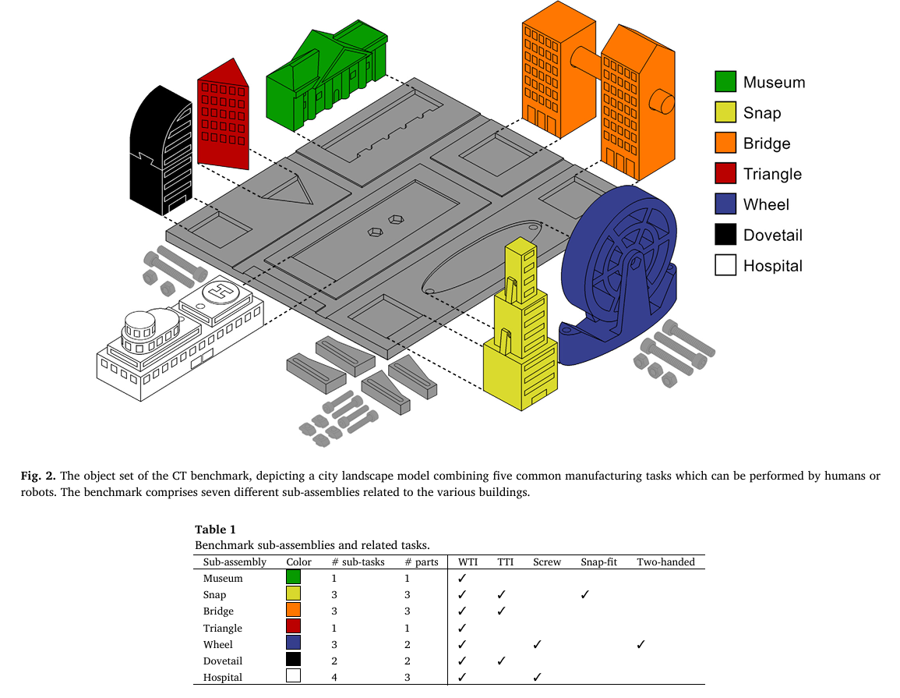
First step: Designan experiment for defining human capabilities matrix
Creating human capability matrix [1]:
Ability corner test: Physical index (PSI), Memory index (MI), and Dexterity index (DI)
Cognitive load assessment: proposed by [1] and [2]
Subjective measures: NAS, NASA TLX, Borg test
Use case proposed by [3]:
wide tolerance insertions (WTI),
the tight tolerance insertion (TTI),
screw fastening,
snap fitting and
two-handed actions.
[1]: Revising the “Ability Corners” Approach: A New Strategy to Assessing Human Capa bilities in Industrial Domains
[2]: An Online Framework for Cognitive Load Assessment in Assembly Tasks
[3]: Benchmarking human-robot collaborative assembly tasks

Slide 8
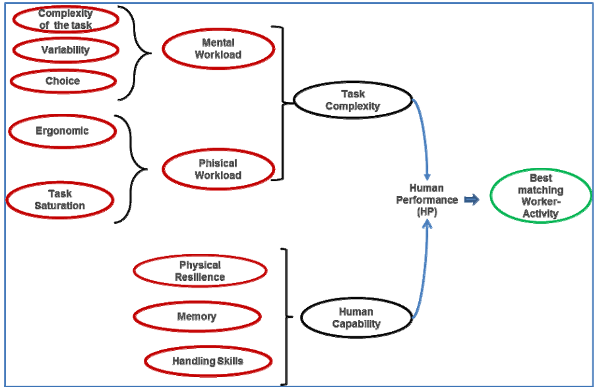
First step: Designan experiment for defining human capabilities matrix
Human performance depends on human capability and task complexity
For defining Task complexity: complexity, number of parts and tools, variability, effort
Human Factor Assessment in Assembly Line: an Operative Model

Slide 9
Second experiment: Let the human assign tasks to themselves or robot
Repeat the same experiment
Let the human do the task allocation
Find correlation between human capability and their allocation
Add some obligations to make it simpler

Slide 10
Next steps:
Check if there is any 3D model of the use case
If not create it
How did they measure time?
Measurement of time, error, …
Tamas: which human capabilities and how to measure it?
Ethical approval: Where the experiment take place.

Slide 11
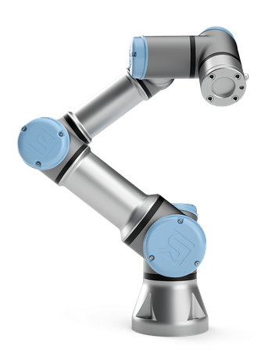
Study design:
First Experiment ~ 60 min:
Training-10 min: start by only robot-3X learning how to do it
Skill assessment- 15min : utilize the document
Human Trials-10 min: only human do the assembly-3X Nasa-TLX
TA trials-10min: 3X trying the TA
Test-2min: Nasa-TLX, supsi collaboration questionary_SUS, general attitude toward robots, DSSQ
Also think of creating an instruction sheet
The time should be short that the human can not do it alone
Work on the questionare
Practiwork idaes:
Reasoning
Psychometric: e.g.Hand dexterity, hand stability,
finger dexterity, arm handiness ~ 15 min
Willingness to make decisions, but the test is not active yet
Pilot study end of April, experiment in June

Slide 12
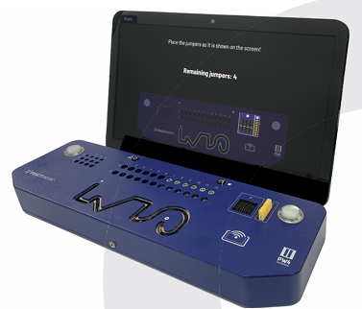
Skill assessment
List of skills:
Precision:
Two hands:
Snipping:
Screwing:
Decision making:

Slide 13
Todos:
3d print the use case 3times + buy the screws--Zahra
Prepare the skill assessment devices-- Tamas
Develop TA interface-- Zahra
Program the robot for doing the tasks
Develop questionares-- Tamas

Slide 14

Zahra Todos
Buy screws- OBI
Connect interface with the robot_ bring the adapter from pilotfactory
Prepare the steps and the environment
Finalize the code with exact movements

Slide 15
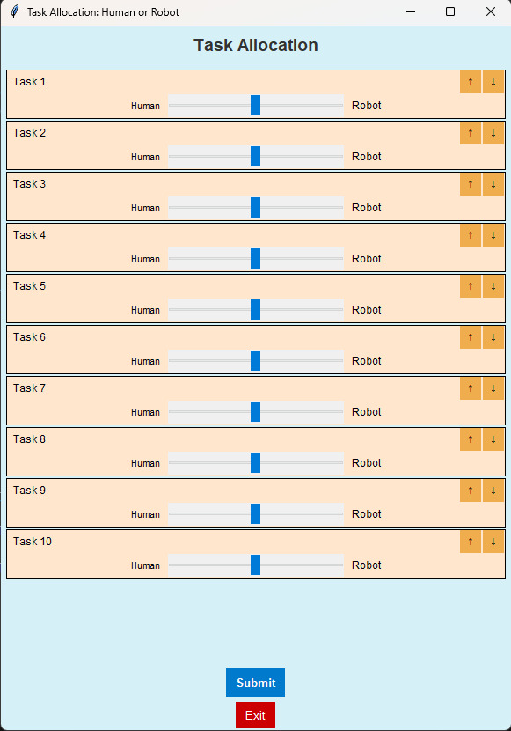
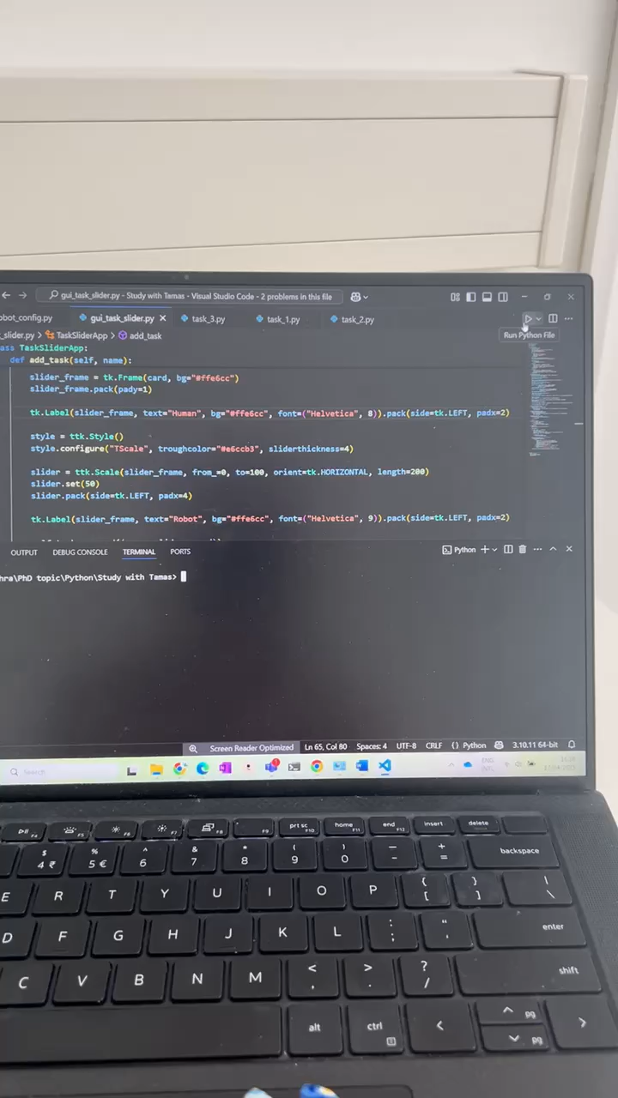
First try:
acc = 0.4
vel = 0.5

Slide 16

Interface and robot:
Order and allocation of tasks will be sent to robot
Same order will be applied for the second set
the robot will do the task without any pause

Slide 17
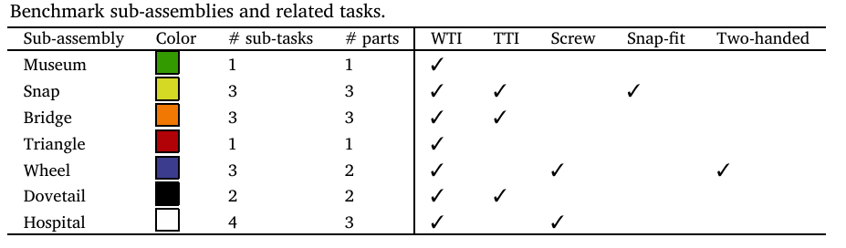
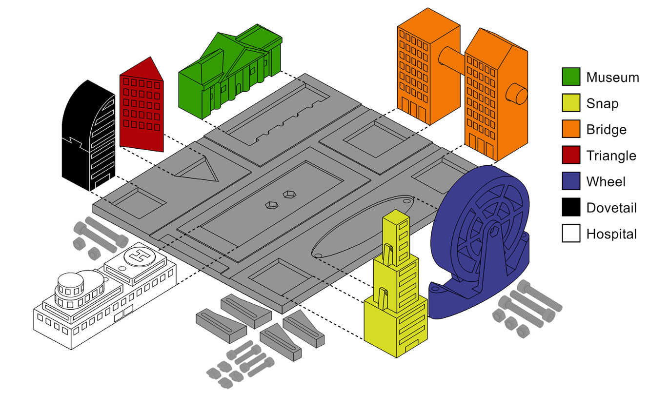
Experiment:
Task | Parts | Type | Agent | Dependency | Robot_time
1 | Museum | W_PP |  | 0
2 | Triangle | W_PP |  | 0
3 | Snap_base | W_PP |  | 0
4 | Snap_middle | Snap |  | 1
5 | Snap_top | Snap |  | 2
6 | Wheel_base | W_PP |  | 0
7 | Wheel_b_screw | screw |  | 1
8 | Wheel | T_PP |  | 1
9 | Wheel_screw | Screw | Only H? | 2
10 | Bridge_home | W_PP |  | 0
11 | Bridge_home2 | W_PP |  | 0
12 | Bridge_rod | T_PP |  | 2
13 | Dovetail_base | W_PP |  | 0
14 | Dovetail_top | T_PP |  | 1
15 | Hospital_base | W_PP |  | 0
16 | Hospital_H | T_PP |  | 1
17 | Hospital_top | T_PP |  | 1
18 | Hospital_screw | Screw | Only H? | 3
Based on the paper, total time of assembly for
Only human: 120 seconds
Collaboration: 205 seconds
Only robot: 419 seconds

Slide 18
Experiment:
First set
Second set
Task | Parts | Type | Agent
1 | Museum | W_PP
2 | Triangle | W_PP
3 | Snap_base | W_PP
4 | Snap_middle | Snap
5 | Snap_top | Snap
6 | Wheel_base | W_PP
7 | Wheel_b_screw | screw
8 | Wheel | T_PP
9 | Wheel_screw | Screw | Only H?
10 | Bridge_home | W_PP
11 | Bridge_home2 | W_PP
12 | Bridge_rod | T_PP
13 | Dovetail_base | W_PP
14 | Dovetail_top | T_PP
15 | Hospital_base | W_PP
16 | Hospital_H | T_PP
17 | Hospital_top | T_PP
18 | Hospital_screw | Screw | Only H?
Task | Parts
1 | Museum
2 | Triangle
3 | Snap_base
4 | Snap_middle
5 | Snap_top
6 | Wheel_base
7 | Wheel_b_screw
8 | Wheel
9 | Wheel_screw
10 | Bridge_home
11 | Bridge_home2
12 | Bridge_rod
13 | Dovetail_base
14 | Dovetail_top
15 | Hospital_base
16 | Hospital_H
17 | Hospital_top
18 | Hospital_screw
Reminder: the goal is to map human capabilities to the TA, in which tasks the robot is better that causes the human to allocate tasks to it?
We can also offer them that the system do the task allocation…
A mapping should be done for the robot programming

Slide 19
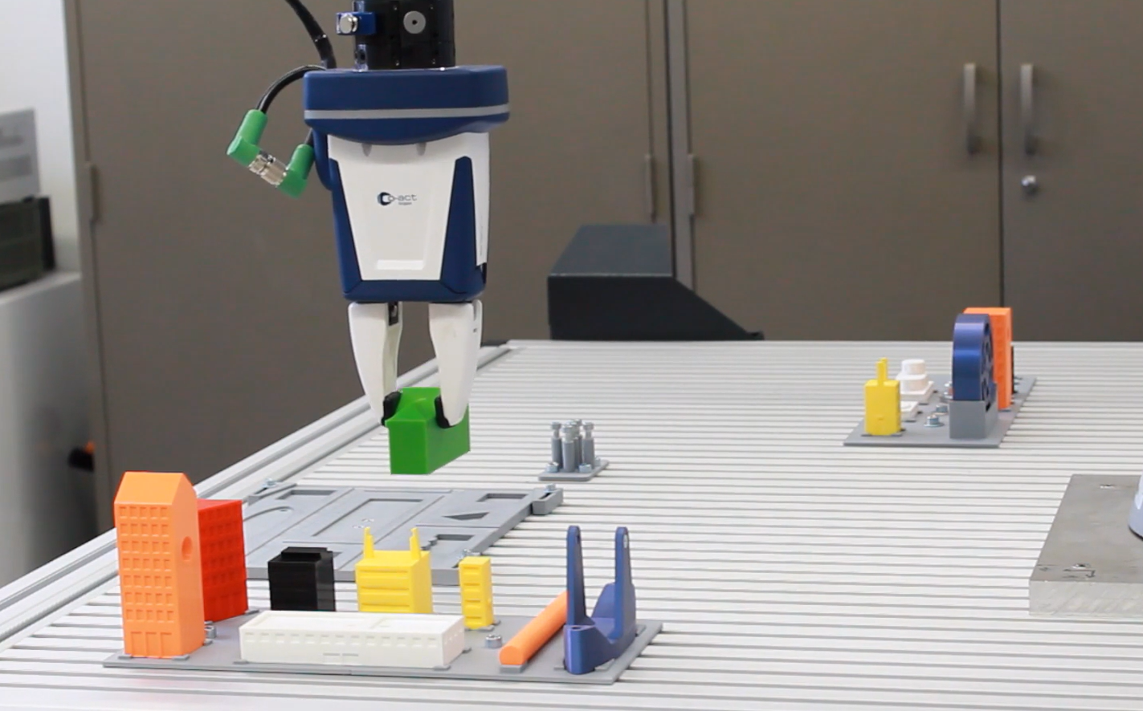
Experiment-next steps
The placement of the parts should be fixed
For each task step the motion of robot should get prepared
The interface and the experiment should get refined later: for each part a block, the blocks can be reordered
Buy screws
Print holders?

Slide 20
Research Questions
To what extent do self-reported human preferences correlate with individual task-related capabilities in human-robot collaboration?
To what extent do human preferences correlate with their perception of robot capabilities in human-robot collaboration?
What factors (e.g., task difficulty, familiarity, trust in the robot) contribute to the formation of individual task preferences in HRC settings?

Slide 21
Comments:
The capability metrics of practiwork are not clearly mentioned and have no scientific background, this would make your results not trustworthy, David suggestion→ keep it subjective
Quantifying the preferences in a range of 0-10 instead ofbinary human/robot
The use case is not well suited for measuring differences in cognitive load, and even for quantifying the physical load
Remove time pressure, it’s limiting factor
Usecase is not very well generalizable
David: keep it only qualitative

Slide 22

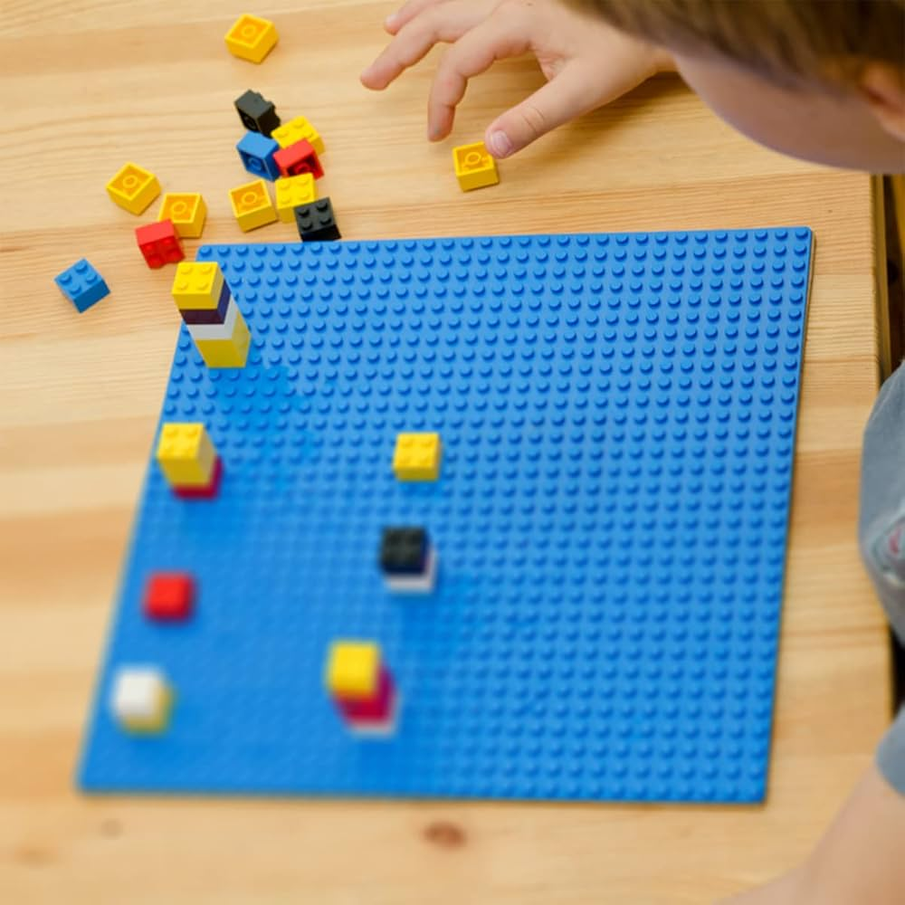
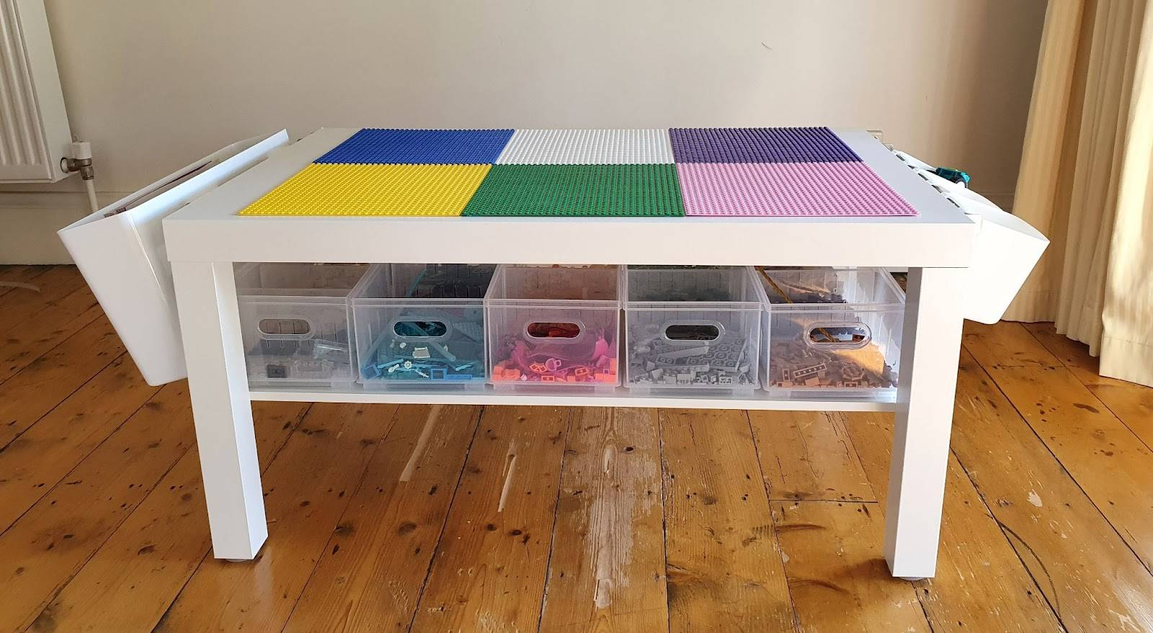
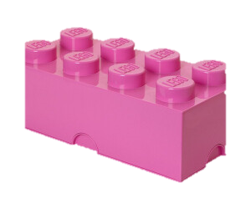
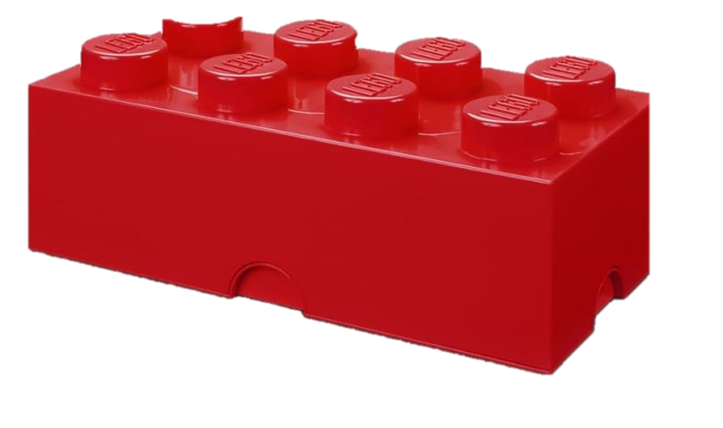
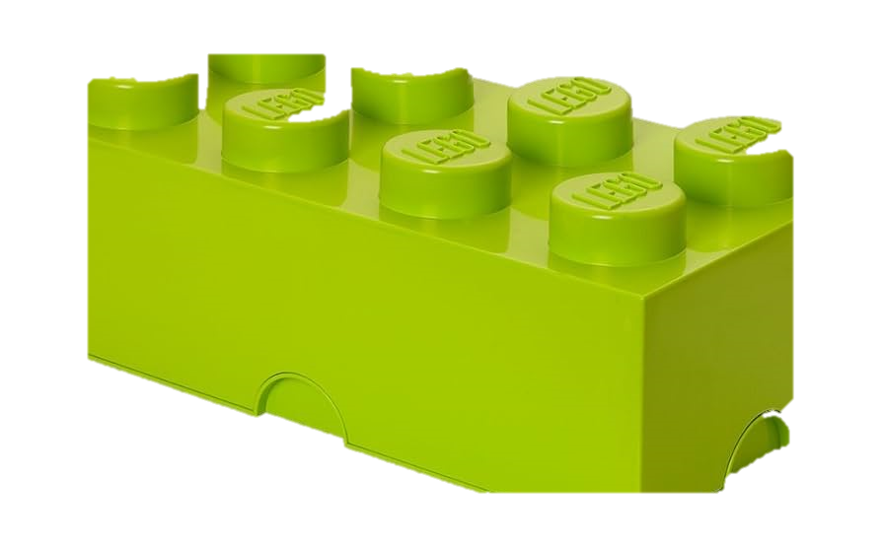
New use case:
Task step time: Number of sub assembly
Physical load→ Reachability, Based on the placement of the objects and reachability
Cognitive: they have to build the mirror of the image, based on the blocks that they have to count
TA: They decide between 0-10 if the robot fits better to do it or the human
4
3
7
2
6
1
5

Slide 23
Updates:
Experiment ~ 60 min:
Skill assessment: Initial perception of human capabilities and robot
Training-10 min: only robot do the assembly
Human Trials-10 min: only human do the assembly
Assessment: Nasa-TLX
TA trials-10min: participants trying the TA with robot
Test-no time pressure:
Data collection: Nasa-TLX, supsi collaboration questionary_SUS, general attitude toward robots, DSSQ

Slide 24
Task list – without robot– for both original use case and the Lego

Slide 25
Cirp Design: Safety integration in mobile robots
Subgroup: Human centric design?
Novelty: tactile sensor for mobile robot?
Methodology? Design of Airskin on Pal?

